Slide 1
Predicting Future Index Fund Using Historical Data
Shareef Shaik - MSBA
DSCI 725 - Data Mining for Competitive Advantage

Slide 2
Introduction
Predicting Future Index Funds of iShares Core S&P Small Cap ETF (IJR) and Schwab International Index Fund (SWISX)
Used date from October 2000 to December 2021 to predict 2023
Support Stakeholders in making improved decision-making.
The Mean Absolute Scaled Error (MASE) is used
as the evaluation metric, providing insights for improved investing decision-making while minimizing risk.

Slide 3
Problem & Background
Accurate forecasting is crucial to optimize Index funds, to track the performance of particular index funds.
Historical data analysis shows Index Funds face challenges like risk and return characteristics.
The project leverages time-series analysis, data visualization, and statistical techniques to develop a forecasting model for accurate predictions.

Slide 4
Data Acquisition & Description
Historical data for SWISX spanning 21 years from Jan-01-2000 to Dec-31-2021 is taken before data cleaning. And the same for IJR Index funds.
Data Source: Yahoo Finance, SWISX, and IJR.
Dependent Variable: Historical Price Data.
Predictor: Year, Month & Price
Data Transformation: Year , Month & Price columns are concatenated to create a new column ‘Date’

Slide 5
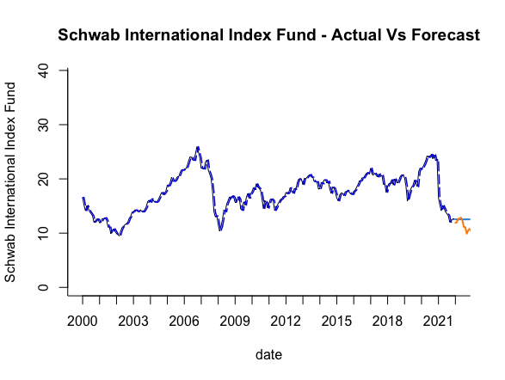
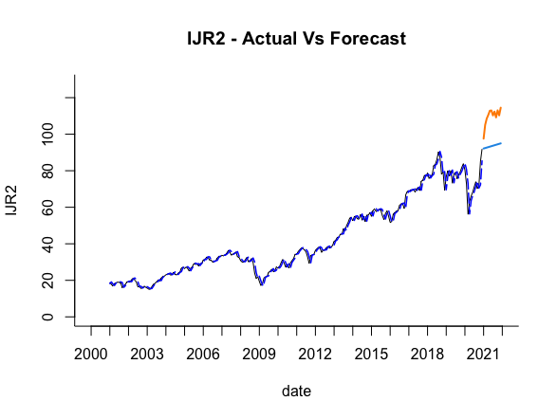
Data Exploration of SWISX and IJR Index funds.
Time Series Components

Slide 6
Models used for Domestic
Air Passengers
Domestic Air Passengers
→ Exponential Smoothing
→ Arima
→ Neural Networks
SWISX | MASE
ETS | 0.3754905
ARIMA | 1.9129785
Neural Networks
IJR | MASE
ETS | 2.7669784
ARIMA | 15.885539
Neural Networks | 9.7279204

Slide 7

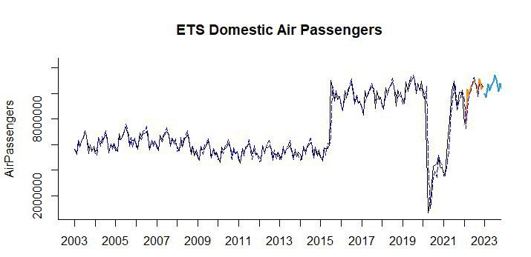
Exponential Smoothing
MASE → 0.5144

Slide 8
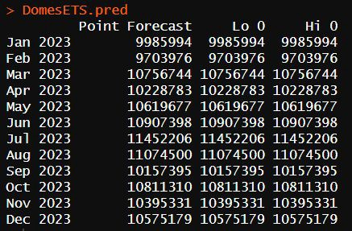
Results
Evaluation Metrics
Predicted Domestic Air Passengers in 2023 for American Airlines

Slide 9
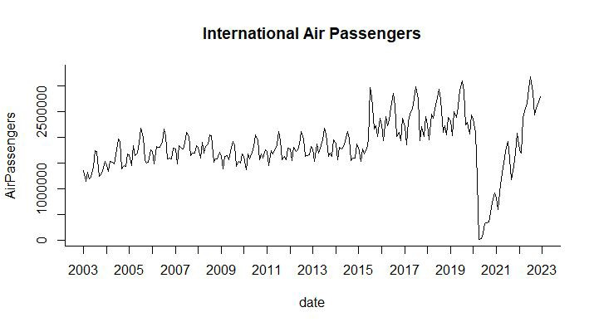
Data Exploration of International Air Passengers
I also plotted my International Air Passengers values in each year from 2003 to 2022 which can be seen in the above graph with date in x-axis and International Air Passengers travelled in y-axis.

Slide 10
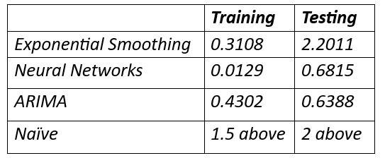
Models used for International
Air Passengers
International Air Passengers
→ Exponential Smoothing
→ Neural Networks
→ Naive
→ ARIMA
MASE

Slide 11
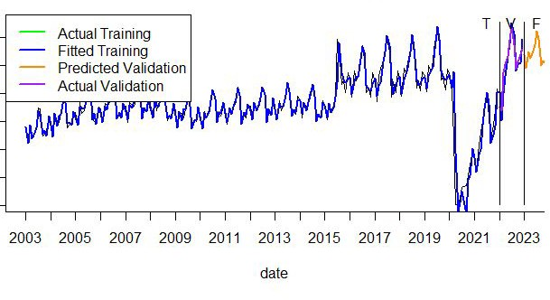
Neural Networks
MASE
Training → 0.0129
Testing → 0.6815
Training Data → January 2003 to December 2021
Validation Data → January 2022 to December 2022
Future or Predicted Data → January 2023 to December 2023

Slide 12
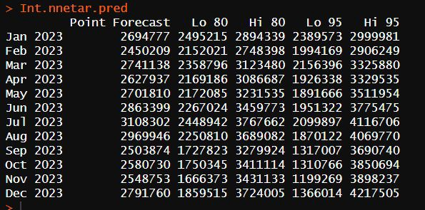
Predicted Data from January 2023 to December 2023
Best Model

Slide 13
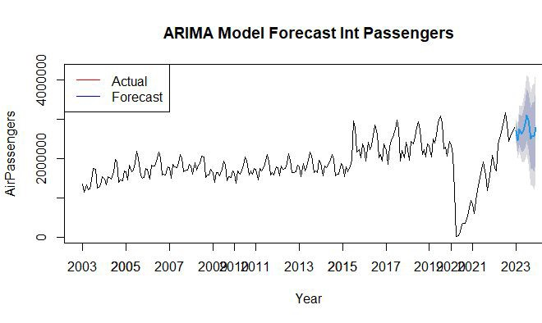
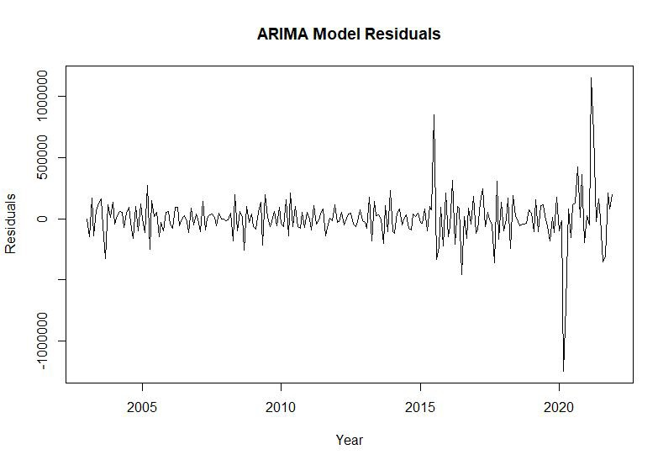
ARIMA
MASE
Training Data → 0.4302 Testing Data → 0.6388
Residuals Plot

Slide 14
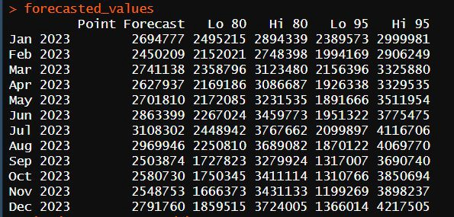
Results
Predicted Data from January 2023 to December 2023
Best Model

Slide 15
Conclusion
Domestic Air Passengers
International Air Passenges
Exponential Smoothing Training → 0.2712
Testing → 0.5144
ARIMA
Training → 0.4302
Testing → 0.6388
This Analysis provides the valuable insights to stakeholders to plan accordingly
Revenue Optimization: Optimize its pricing, Capacity, Marketing strategies to maximize revenue.
Operational Eﬃciency: Better plan and allocate resources, such as aircraft, crew, and services, leading to improved operational eﬃciency and cost savings.

